Slide 1

TUTORIAL 5: HIGH PERFORMANCE DATA ANALYTICS 101
Hui Liang, Lead Data Scientist
Wei Ann Lim, Data Scientist
APJ Innovation Center, Hewlett Packard Enterprise, Singapore
March 13, 2017

Slide 2
Schedule
9:00 am – 10:30 am
10.30 am – 11.00 am
11.00 am – 1.00 pm
1.00 pm – 2.00 pm
Track 1 Machine Learning
Morning Tea Break
Track 2 Text Analytics, Track 3 HPC & Data Analytics
Lunch Break

Slide 3
Track 1: Machine Learning
Wei Ann Lim, Data Scientist
APJ Innovation Center, Hewlett Packard Enterprise, Singapore
March 13, 2017

Slide 4
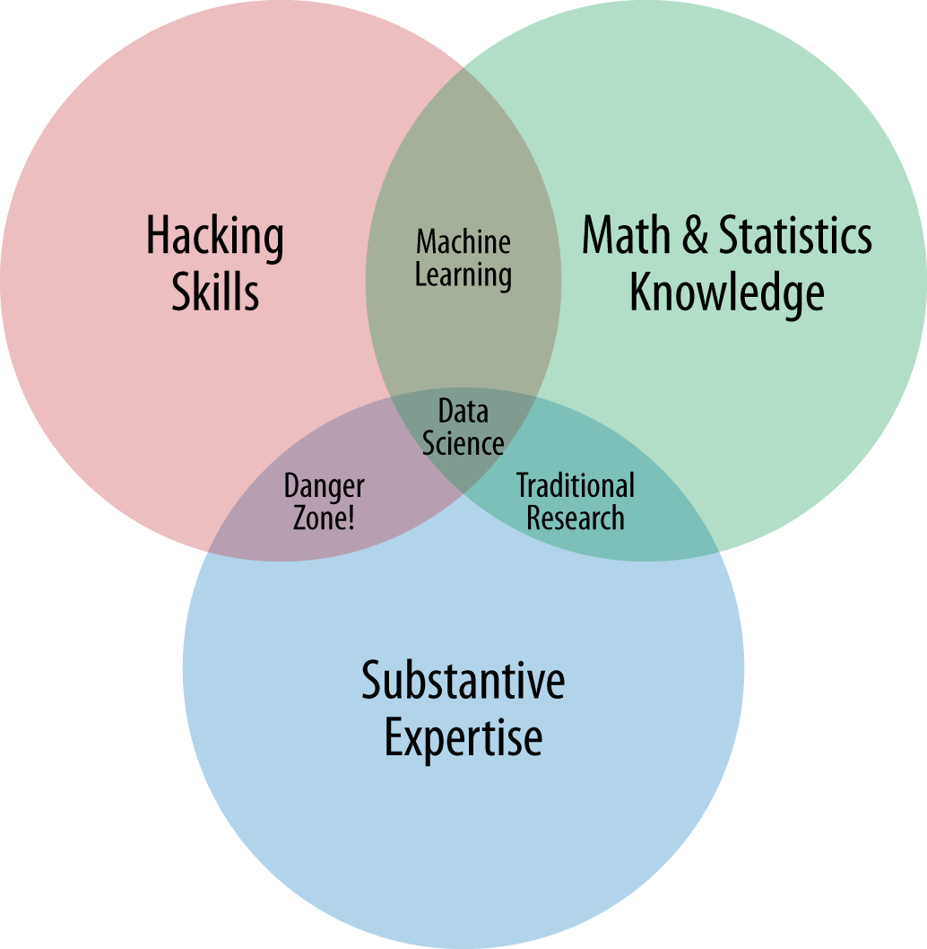
Introduction
Data Science, Machine Learning , Business Analytics, Deep Learning.
Business Analyst? Business Intelligence?
Artificial Intelligence!
Venn Diagram by Drew Conway
Definition of Data Science

Slide 5

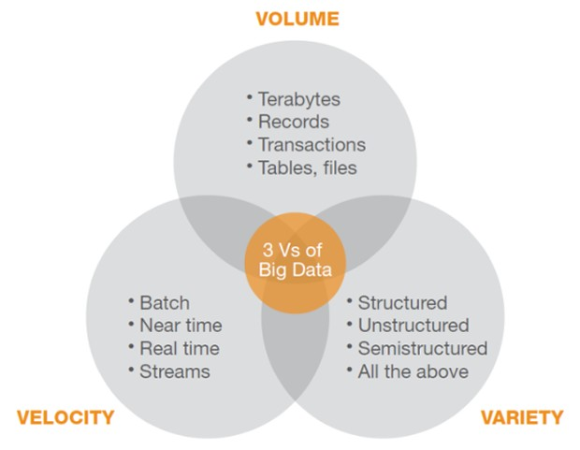

Slide 6
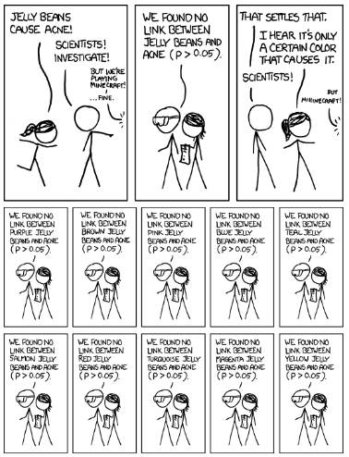
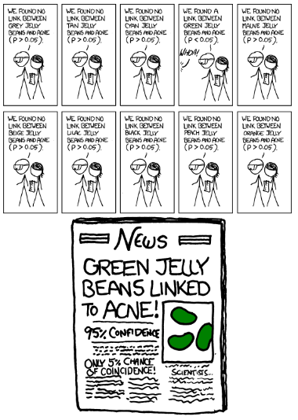
Notes:
Be careful of spurious relationship.

Slide 7
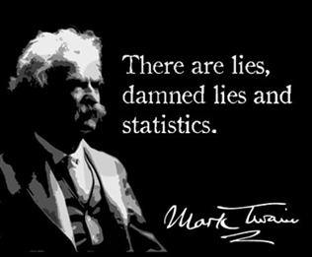
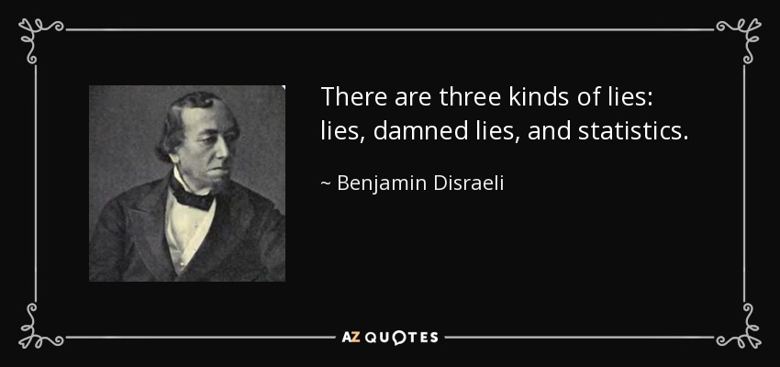
Notes:
Fake quotes?
The term was popularized in the United States by Mark Twain (among others), who attributed it to the 19th-century British Prime Minister Benjamin Disraeli
Trust Wikipedia.

Slide 8
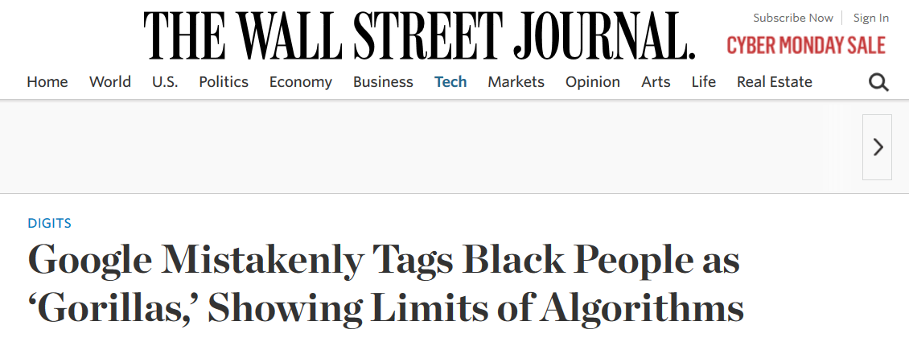
Be Careful

Slide 9

















Data Analysis Pipeline
Get Data
EDA
Data Stores
Exploratory Data Analysis
Types of data (continuous, categorical, hierarchical)
Data Pre-processing
Building Models
RDBMS
HDFS
NoSQL
Quirks
Biases and distribution of data
Prepare to Build the Model
Training, validation, and test data. (e.g. 60%, 20% 20%).
Is the data a sequential data?
Data cleanup – remove NAs, fill blanks, normalize data etc.
To do
Do not choose variables you cannot get at production time as features.
Choose evaluation criteria and train hyper-parameters.
Choose the best model.
Build Data Product
Considerations
Monitor performance of model.
Decide model update frequency.
Technical support

Slide 10
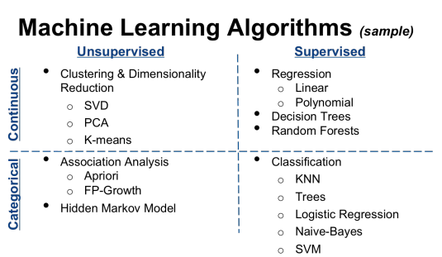
Notes:
Picture from https://medium.com/@RobinCRLee/supervised-vs-unsupervised-learning-36d5106c7b0b#.fn1df7j6v

Slide 11
Regression

Slide 12
Assumption About You
You have basic understanding of middle school mathematics
Square root.
Scatter Plot.
Mathematical symbols like differentiation, integration, and summation.
Statistics e.g. mean, median, mode, variance, standard derivation
Notes:
And my goal here is to make you fall asleep.
If you don’t, I am not doing a good job explaining how regression works to you.

Slide 13
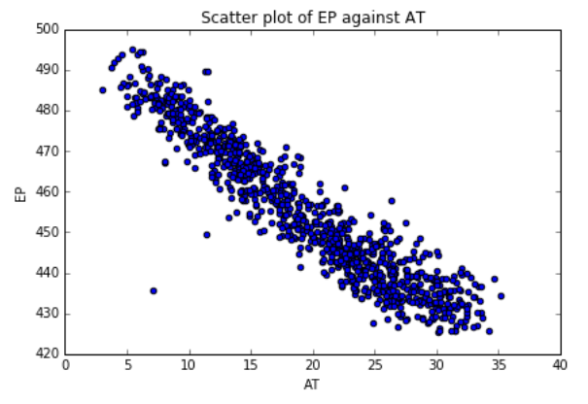
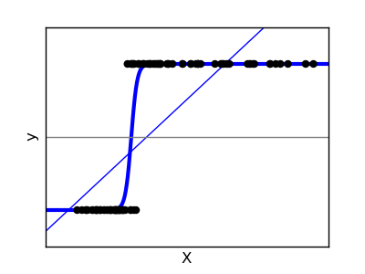
Types of Regression
Types of Regression
Predict Value
Linear Regression
Value expected
Classification
Logistic Regression
A or B?
Notes:
There are 2 broad classes of regression techniques:
1. predicting continuous values
And another for predicting categorical values aka different classes e.g. diseased or not diseased, spam email or not.

Slide 14
What is Linear Regression
“Grand-daddy” of all “Machine Learning” Algorithm
Identifying the linear relation between independent variables (X₁, X₂ … X_{n}) and dependent variables (Y).
Prediction about the dependent variable can be made by knowing the independent variables.
Control the value of the dependent variable.
Relationship between the ambient temperature and electrical power output of in a power station.
Notes:
The goal is, given a set of variable, find the relationship between the independent variables and the dependent variable.
And we are going to find this relationship using math
The basis of most machine learning algorithm is math.
In this case, X = ‘AT’, Y = ‘EP’

Slide 15
Finding Relationships
Relationship between the ambient temperature and electrical power output of in a power station.
Notes:
Is this line good enough?

Slide 16
Logistic Regression

Slide 17
What is Logistics Regression
Types of Regression
Predict Value
Linear Regression
Value expected
Classification
Logistic Regression
A or B?

Slide 18







Logistic Regression vs.. Linear Regression
Linear Regression
Logistic Regression
Find the best hyperplane that is best able to go through all the data.
Output is a continuous values.
Cost function
Find the best hyperplane that is able to separate the data into 2 groups.
Output is a binary value
Cost function

Slide 19
Clustering

Slide 20
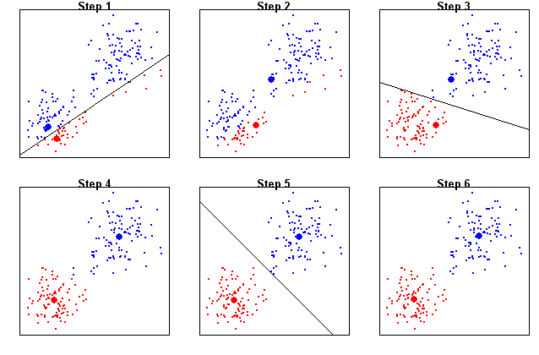
What is Clustering?

Slide 21
Clustering Algorithms
Hierarchical Clustering
Kmeans Clustering
Bottom Up
Number of clusters required is unknown at the start.
Group 2 nearest points into a cluster.
Has a clear end to the algorithm.
Top Down.
Number of clusters required is “known”.
Assign a number of data points as the cluster centers and assign the other data points to the cluster center nearest to it.
Not always clear when algorithm is good enough.
See More in the Demonstration.

Slide 22
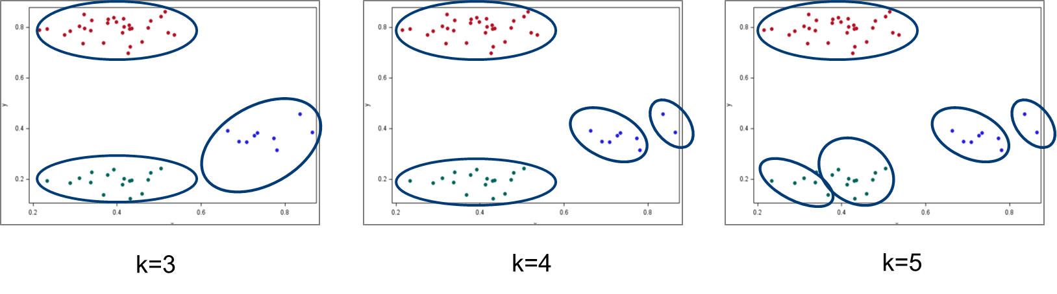
Clustering Is Easy, Isn’t It?

Slide 23
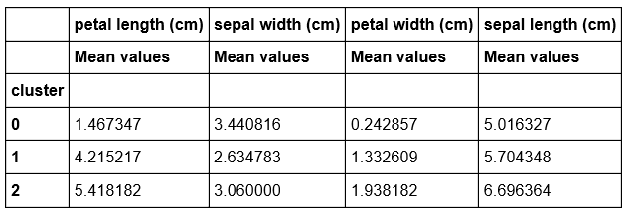
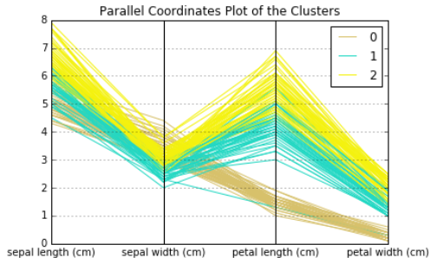
Characteristics of Clusters

Slide 24
Lesson Summary
Notes:
We have see the many common terms to describe what is being done in this field.
Data Science, business analytics, machine learning, deep learning, AI. I have attempted to give my own interpretation.
But really, there is no single definition, only subtle differences.
Then we went on to see what’s going on in linear regression, logistic regression and clustering. This is just tip of the ice berg.
You’ll realize that machine learning means making decisions using mathematics.
In this short time, we were unable to discuss the problem of overfitting, the curse of dimensionality, and the different problems that we can see in data, and how to deal with them.
But my advice is, visualize the data, understand the spread of the data, decide whether normalization is required before apply a machine learning algorithm.

Slide 25
Take Away
Models in data science are based on Mathematics.
Know your data before building models.
About formulating the cost function, and adjust the parameters by iterations.
Visualizing how values, parameters etc. change can help in finding the best parameters.
The best model is dependent on the nature of the data.
Estimate performance of the model on test data.
Normalize the variables before building model.

Slide 26
Advance Topics
Spurious Correlation, Quirks in modelling, Inferring Data
Class Imbalance
Regularization
L1 regularization, aka, Lasso
L2 regularization, aka, Ridge Regression
Batch learning, online learning
And many, many more... ...

Slide 27
Thank You for Your Attention

